Slide 1
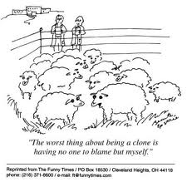
Livestock animals

Slide 2
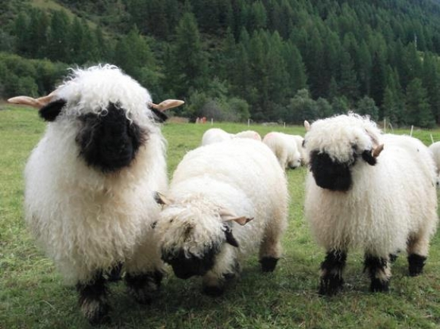
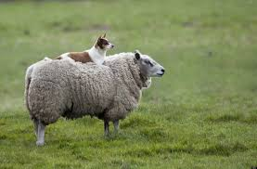
Food and Fiber
First food and fiber animal was the sheep(Ovis Aries)
Reasons:
They stay together, survive off poorer and marginal land, manageable size, low aggression, and versatile.

Slide 3
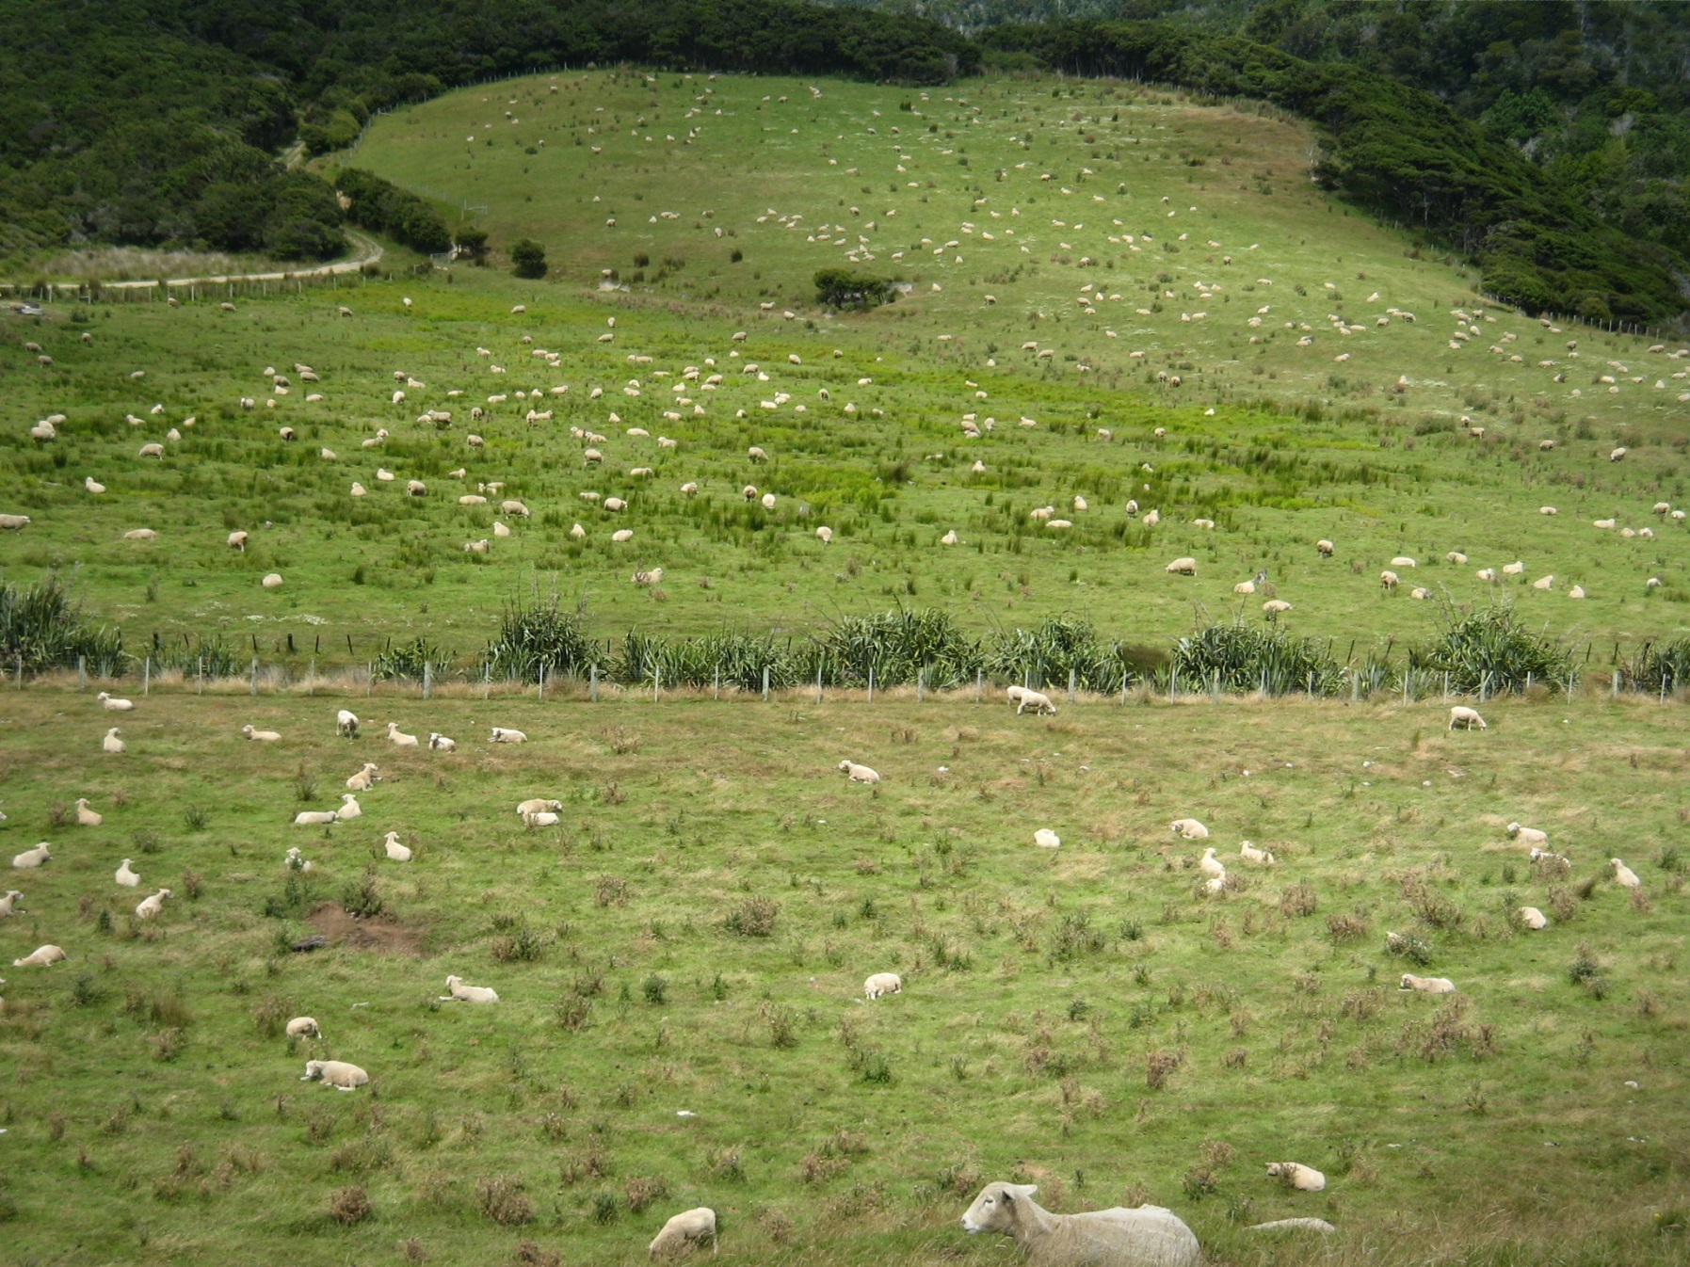
New Zealand-North Island

Slide 4
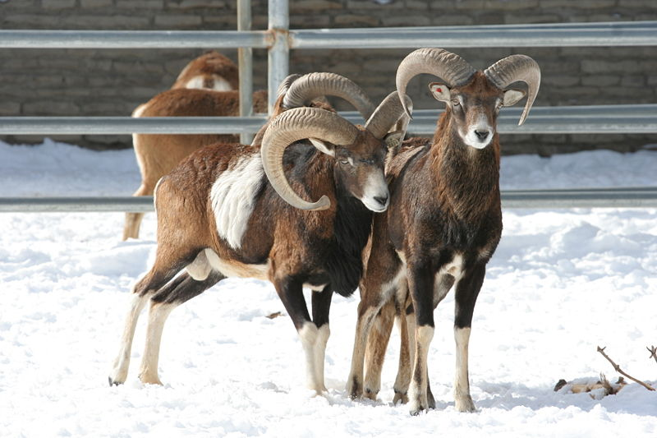
Origin of Ovis aries
The Mouflon- a possible ancestor (scientists aren’t sure)
Domesticated ~11,000 years ago in Mesopotamia(today’s Iraq).

Slide 5
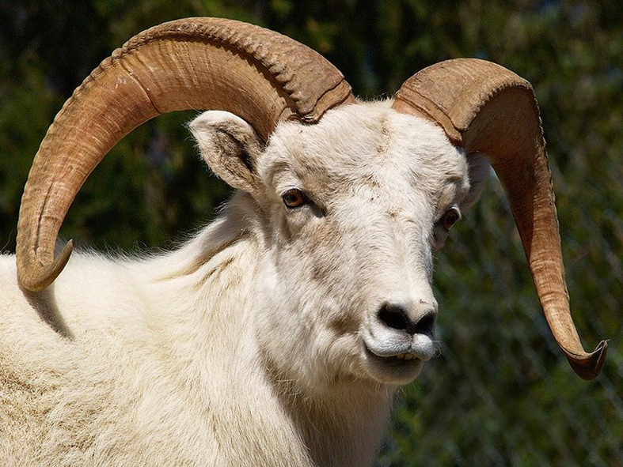
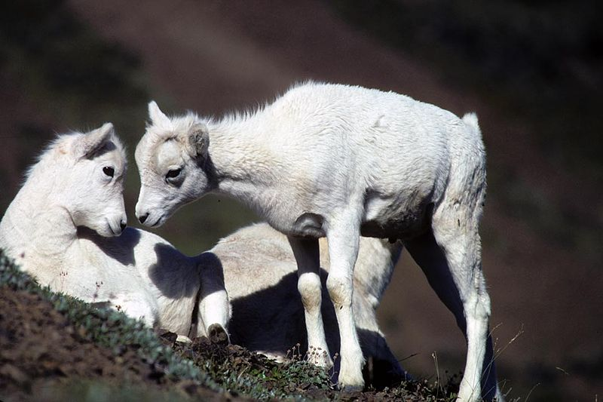
Origin of Ovis aries
Dall Sheep- Ovis dallis
Wild sheep native to NW North America

Slide 6
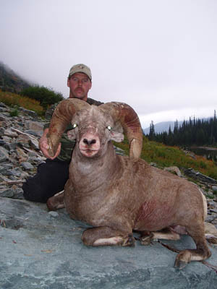
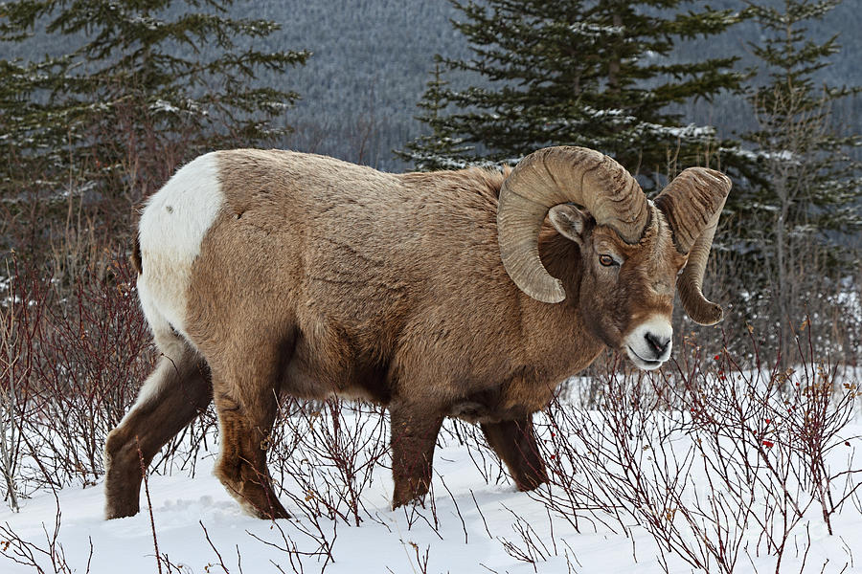
Origin of Ovis aries
Big Horn Sheep
Wild sheep native to NW North America

Slide 7
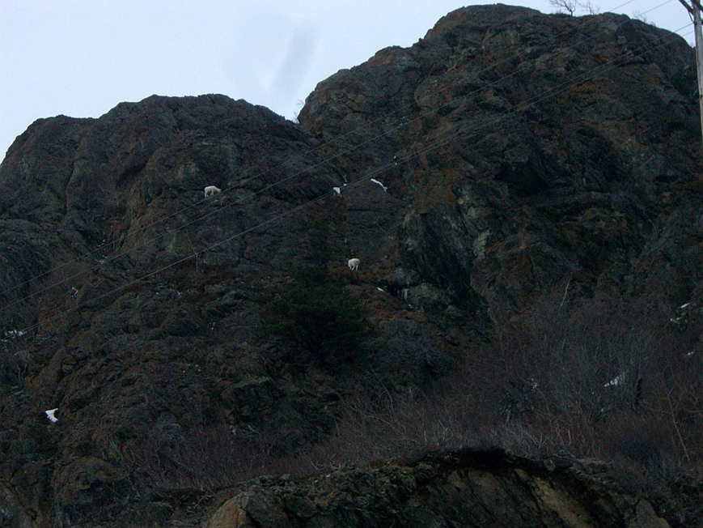
Dall Sheep on Beluga Point, AK

Slide 8
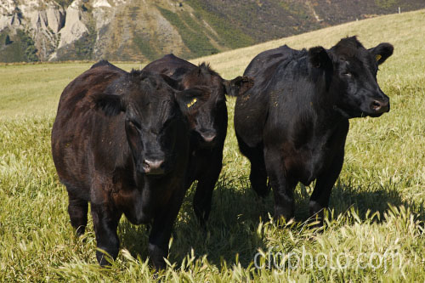
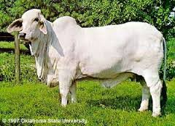
Food and Labor
Bovines: Bos taurus and Bos indicus
c

Slide 9
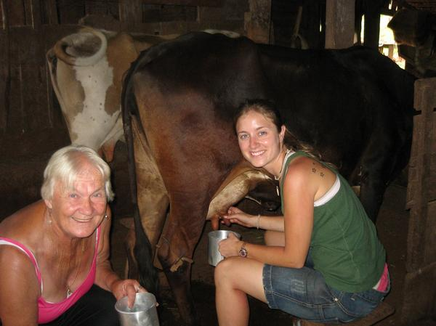
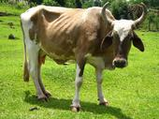
Food and Labor
Bos indicus type cows in Brazil.

Slide 10
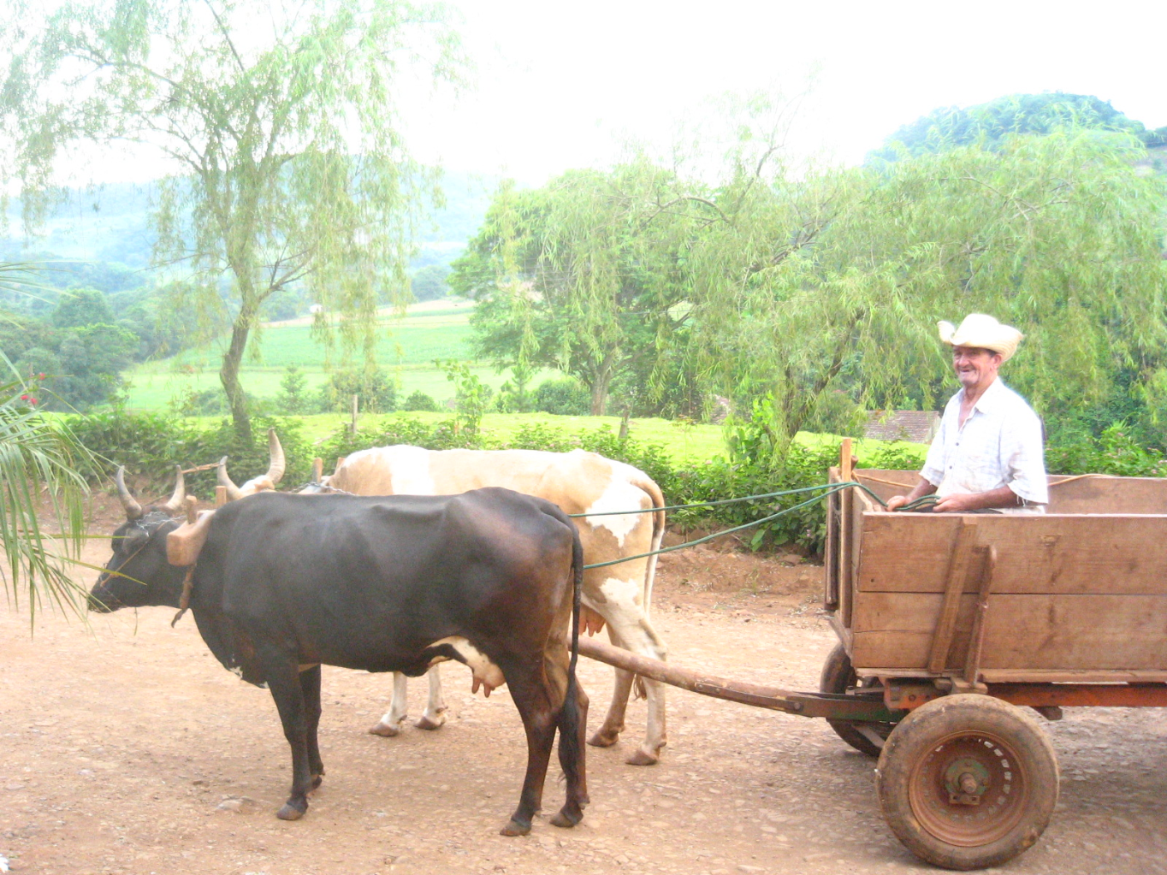
Food and Labor
Bos indicus type cows in Brazil.

Slide 11
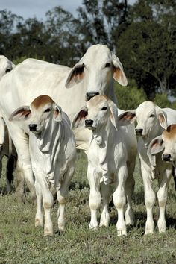
Food and Labor
Bos indicus type cows in Brazil.
Where do these types of cows usually live? Why do they look so different?

